Slide 1



JU Hackathon 2019
POWERED BY :
ORGANISED BY :
IN ASSOCIATION WITH :
Team Number: 63
Team Name: Team Solo Print( )
Team Member Names: Rithwik Sudharsan

Slide 2
JU Hackathon 2019
Target Users
Primary: English language students/teachers (beginner ← → native speaker)
Any Language is possible
Other subjects involving English essays (ex. history)
Standardized testing
College admissions
Extendable to:
Resume / Cover Letter (both for job seeker and HR dept.)
Problem Statement
Automated grading for subjects like math is so well established that you wouldn't call it automation. Unfortunately, all the benefits of this (personalization, tracking of growth, easy grading for teachers/proctors…) have not been translated to be used with written materials almost anywhere.
There should be "Scantrons" for writing. Cheap, Quick, (Reduced) Bias.

Slide 3
JU Hackathon 2019
Solution
Issue: Need deep understanding → get lots of data! But we don't have that.
Used a Universal Language Model and a simple web UI to demonstrate that a small amount of data can reach amazing accuracy.
Grades in 6 areas:
Ideas and Content
Organization
Voice
Word Choice
Sentence Fluency
Conventions
Technology Brief
A sophisticated language model architecture is trained to predict the next word in a corpus of tons of data (all of Wikipedia, for ex.) Intuitively, it must understand language somewhat well if it performs well here. Then, an additional layer can be added to finetune the language model to produce a specific type of output for a specific problem with a small amount of data to adjust the output representation.
Data already exists with companies, for example past human-graded SAT or GRE essays or already-screened resumes and cover letters by HR departments.

Slide 4
Summary w/ Criteria
Creativity: First ever essay grading attempt to use universal language models, first one to predict multiple rubric labels instead of just 1 label, which is much more helpful.
Usability: Simple, a company collects a small amount of data (less than 1K samples alone is pretty good), fine-tunes it with something like BERT, and has a great vetting system to provide an accurate grade.
Technicality: Uses state-of-the-art model for fine tuning.
Scalability: As more tasks wish to use this, they can easily provide their existing data and have a model deployed within a few hours at absolute max. Also, the same fine tuning can generalize across almost any type of natural language writing, from cover letters to history essays to fantasy writing.
Business: It is clear that teachers, college admissions, standardized test agencies, and HR departments would all love to quickly process through all their paperwork. Also, students can learn to improve their writing (this could be an educational business).
Theme: The same way how Scannable bubblesheets and KhanAcademy have digitized education, this can do the same and far beyond.

Slide 5
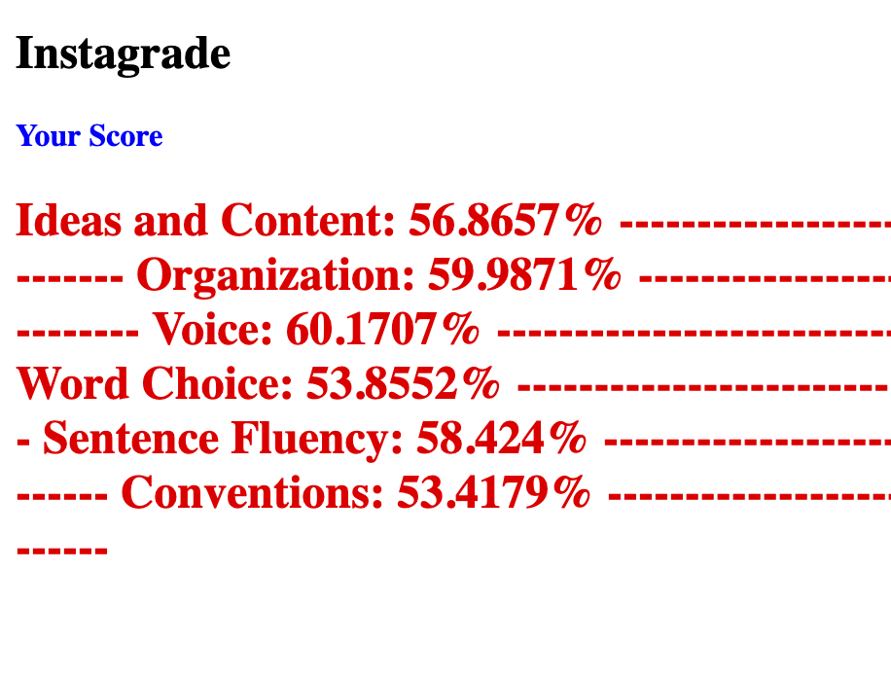
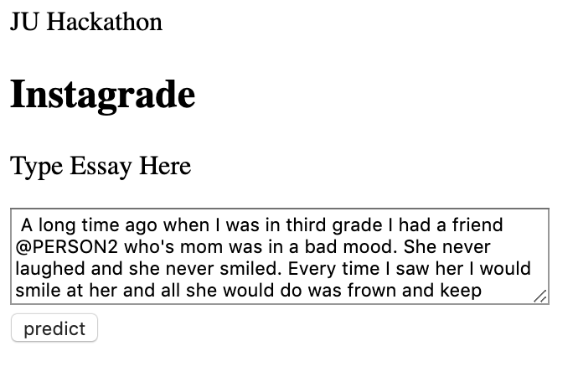
JU Hackathon 2019
Picture of Prototype/Screenshots

Slide 6
JU Hackathon 2019
Status of the Model/Prototype Achieved
Top Kaggle score: 0.81407 (with 100% of data / 13K examples) to predict 1 grade
My accuracy: 0.941 (with 5% of data / 750 examples) to predict 6 rubric grades
Ideas and Content
Organization
Voice
Word Choice
Sentence Fluency
Conventions

Slide 7
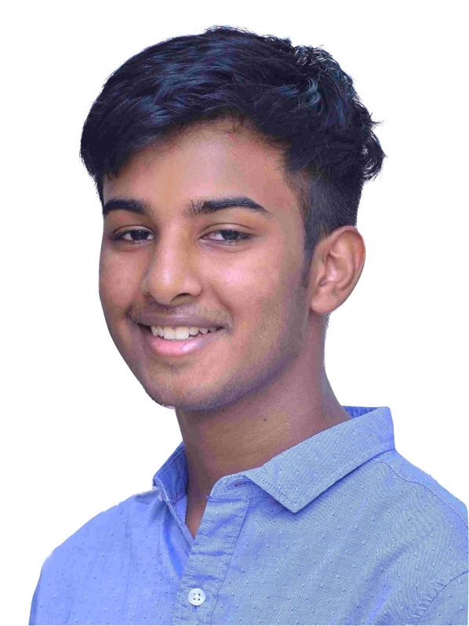
JU Hackathon 2019
Team Photo (a photo of me…)

